Slide 1

RAILWAY RESERVATION SYSTEM
CSI1007 – Software Engineering Principles Laboratory
23MID0403
Aadithya S

Slide 2
RAILWAY RESERVATION SYSTEM
Description:
The Railway Reservation System project aims to design and develop a web-based application for booking and managing railway tickets. It provides features like user registration, train search, booking, payment gateway integration, and administration modules. The system ensures a user-friendly, efficient, and secure ticketing experience for customers.
Scope of the project:
The Railway Reservation System project aims to design and develop a web-based application for booking and managing railway tickets. It includes features like user registration, train search, booking, payment gateway integration, and administration modules. The system ensures a user-friendly, efficient, and secure ticketing experience for customers
Impact of the developing Project:
Developing projects are revolutionizing railway reservation systems through digital platforms, AI, and IoT, enabling real-time bookings, dynamic pricing, and personalized services. Modern infrastructure supports high-speed rail integration and smart stations. Challenges include legacy system upgrades and cybersecurity. Future trends point to facial recognition boarding, AR navigation, and eco-friendly travel options. These advancements enhance efficiency, accessibility, and passenger experience while optimizing operations.

Slide 3
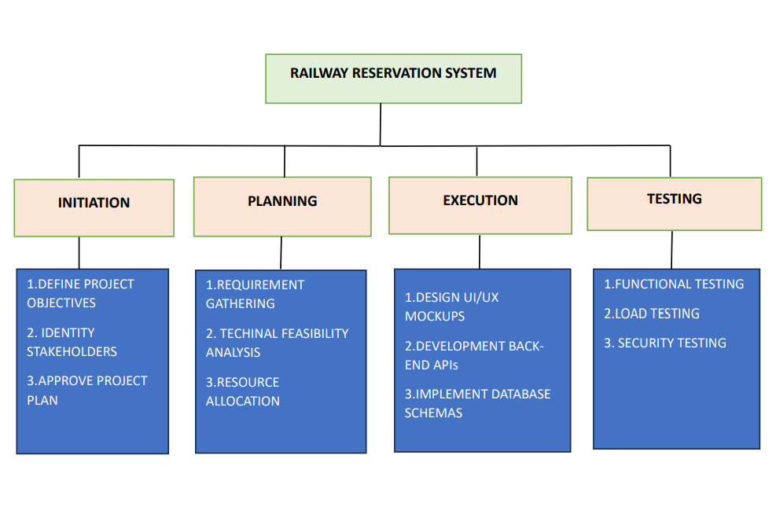
Work Breakdown Structure
Process-Based Work Breakdown Structure:

Slide 4
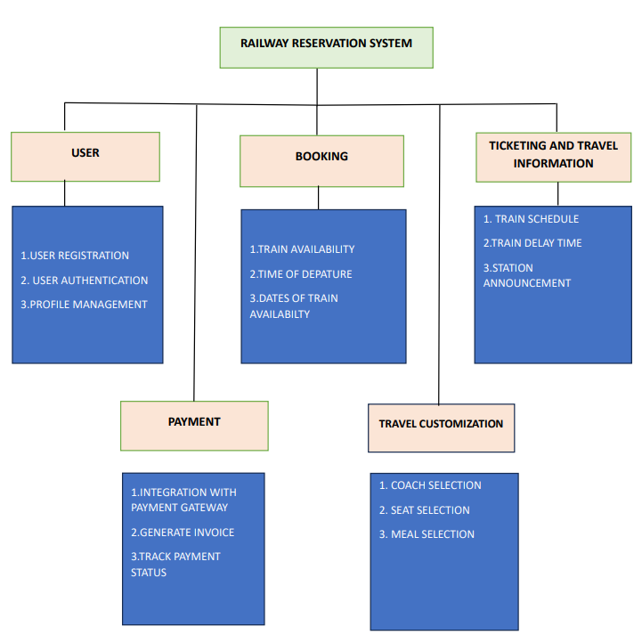
Work Breakdown Structure
Product-Based Work Breakdown Structure:

Slide 5
SRS Document
Functional Requirements:
1 User Interfaces
• Intuitive mobile and web interfaces with support for multiple languages.
• Web Interface: A responsive, user-friendly interface accessible on desktop and mobile browsers (Chrome, Firefox, Safari, Edge).
• Mobile App: Native apps for iOS and Android with intuitive navigation and seamless integration with the core system. • Multi-language Support: The system supports multiple languages (e.g., English, Hindi) to cater to a diverse audience. • Responsive design for usability across devices.ntuitive UI for customers and restaurant owners.
2 Hardware Interfaces
• Server Requirements: High-performance servers with SSD storage and 32 GB RAM
• Storage: SSD-based storage for fast data access and processing.
• RAM: Minimum of 32GB RAM for handling multiple concurrent requests.
• Load Balancers: Used to distribute incoming traffic evenly across servers, ensuring high availability and performance during peak traffic..
• Client Devices: Smartphones, tablets, and PCs.

Slide 6
3 Software Interfaces
• Integration with APIs for payment processing, SMS notifications, and email services
• External APIs that provide real-time data on train schedules, delays, and cancellations.
• Helps keep users informed about train statuses and seat availability.
• Integration with analytics tools (e.g., Google Analytics) to track user behavior, system performance, and improve overall service delivery.
• Cloud-based storage for user data, logs, and other system-related files, ensuring easy retrieval and backup. Services like AWS S3 or Azure Blob Storage may be used.

Slide 7
4 Communications Interfaces
• Secure HTTPS protocols for all communications
• All communications between the client and server will be secured using SSL/TLS encryption to protect user data and ensure secure transactions.
• Ensures data confidentiality and integrity while preventing unauthorized access.
• Real-time communication for features like live seat availability updates, train status notifications, and other real-time alerts.
• Provides a persistent connection for continuous data flow between the server and the client, improving the user experience.
• Real-time push notifications sent to users via mobile apps for booking updates, reminders, and alerts about train status (delays, cancellations).
• Uses mobile platform services like Firebase Cloud Messaging (FCM) for Android and Apple Push Notification Service (APNS) for iOS.
5 Ticket Booking
1. The system shall allow users to search for trains and check availability.
2. The system shall enable users to book tickets for a selected train and date.
3. The system shall generate a unique PNR (Passenger Name Record) number for each booking

Slide 8
SRS Document
Non-Functional Requirements:
1 Performance Requirements
• The system must handle 1 million concurrent users without significant performance degradation.
• The architecture should be designed to scale horizontally, adding more servers or resources to meet demand during peak traffic periods.
• The response time for core operations, including ticket search, booking, and payment processing, should be less than 2 seconds to ensure a fast and seamless user experience.
• Real-time updates, such as seat availability and train status, should be delivered with minimal latency (under 1 second).
2 Safety Requirements
• Data must be encrypted during transmission and at rest
• Use SSL/TLS for secure transmission and AES-256 for data at rest.
• Regular automated backups and a disaster recovery plan to ensure data integrity.
• Use PCI-DSS compliant third-party gateways for secure transactions; never store sensitive payment information.
• Backup mechanisms to ensure data recovery in case of failure.nsure customer data privacy

Slide 9
3 Security Requirements
• The Railway Reservation System (RRS) must implement robust security measures to protect user data, prevent unauthorized access, and ensure the integrity of transactions.
• Multi-Factor Authentication (MFA) should be supported for additional security.
• Role-Based Access Control (RBAC) must be implemented to restrict administrative privileges
• Ensure all payment transactions are processed via PCI-DSS compliant gateways, ensuring secure handling of payment data.
• Implement tokenization or 3D Secure for added security during payment processing.
• Conduct regular penetration testing and vulnerability assessments to identify and address potential security flaws.
• Perform security audits periodically to ensure compliance with security policies and best practices.

Slide 10
4 Software Quality Attributes
• The Railway Reservation System (RRS) must adhere to the following software quality attributes to ensure reliability, security, and usability.
• The system should provide quick response times, even under high load conditions, ensuring that operations such as searching, booking, and payment processing take less than 2 seconds.
• The system should handle 1 million concurrent users and ensure high throughput without compromising performance.
• The system should maintain 99.9% uptime to ensure uninterrupted access for users.
• The system should provide real-time feedback for user actions, such as booking confirmations and payment statuses
• The system must be able to integrate with external systems like payment gateways, SMS/email providers, and external databases.

Slide 11
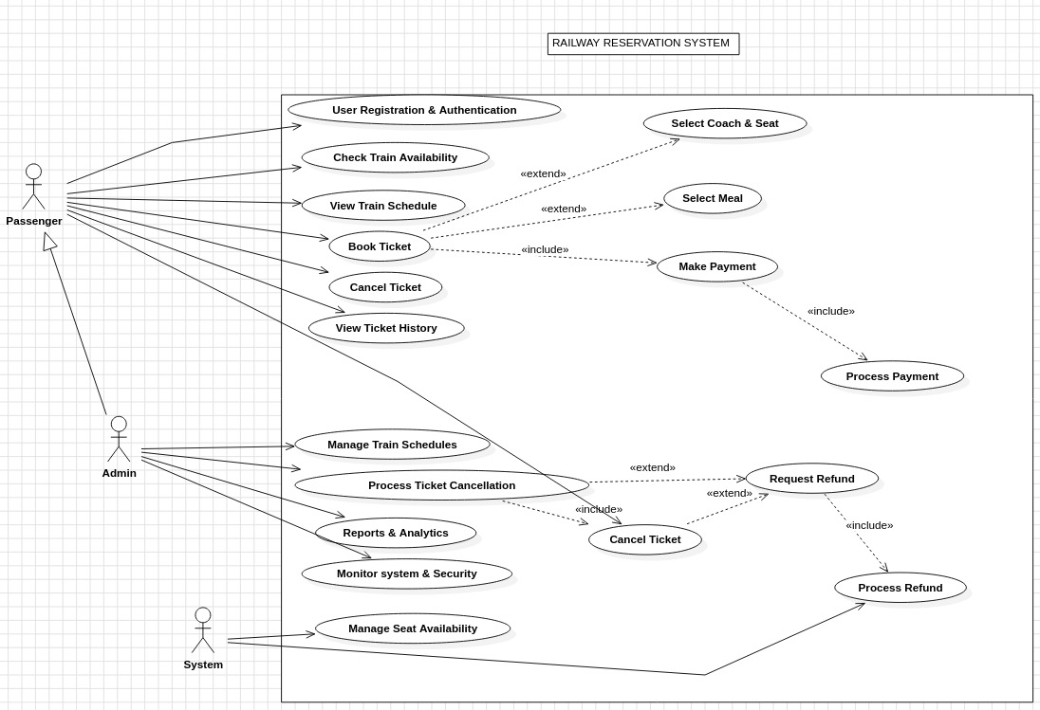
UML - Diagrams
Use-case diagram:

Slide 12
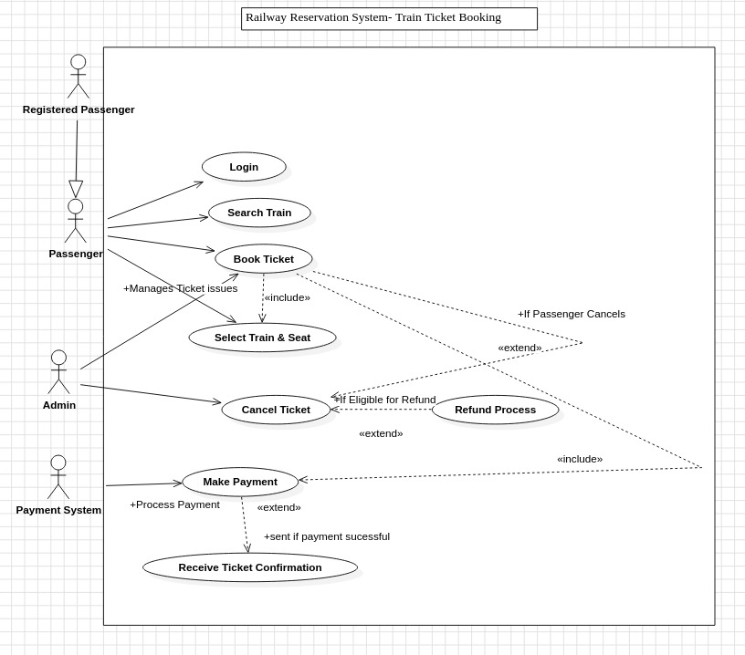

Slide 13
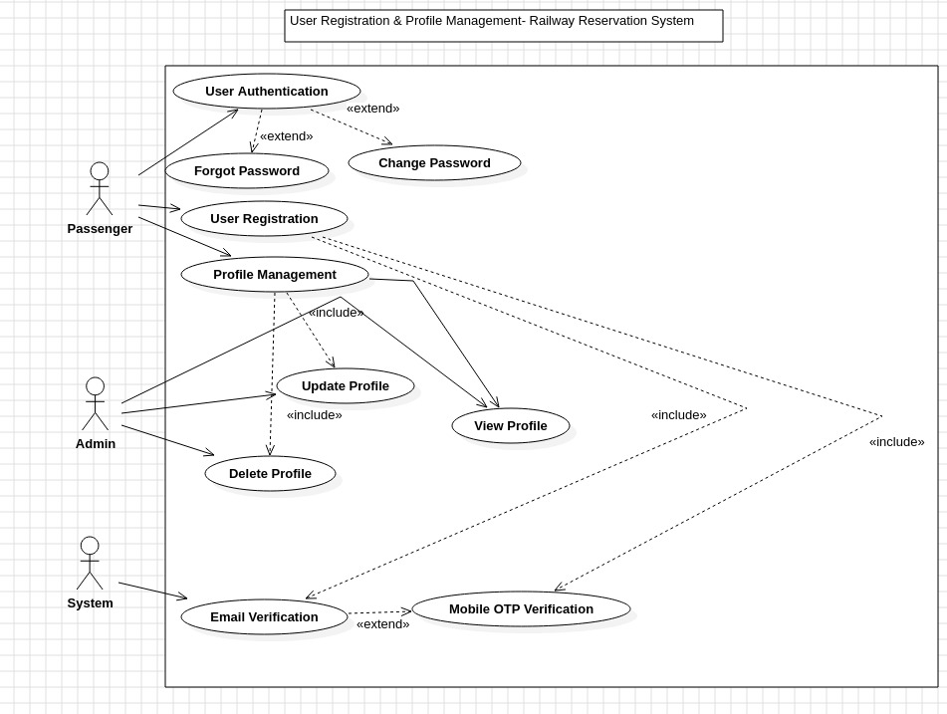

Slide 14
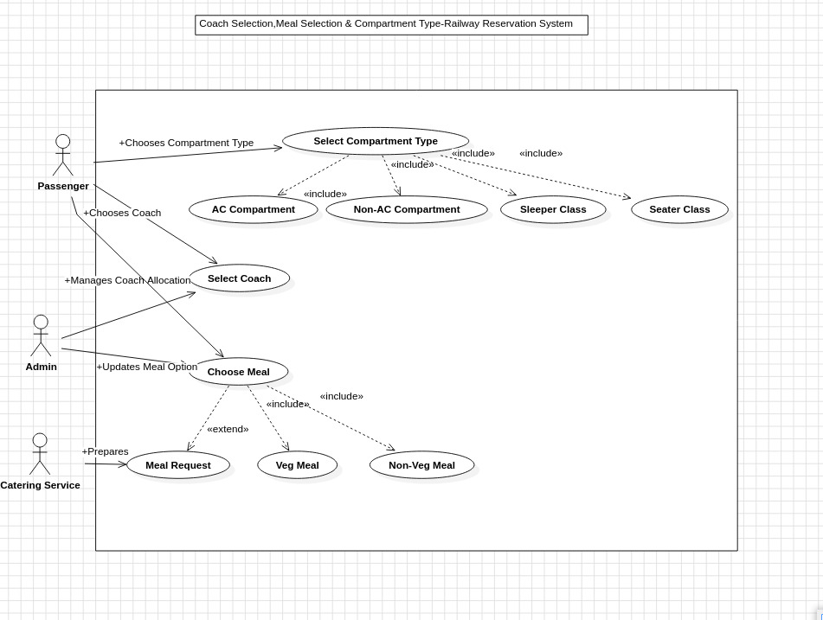

Slide 15
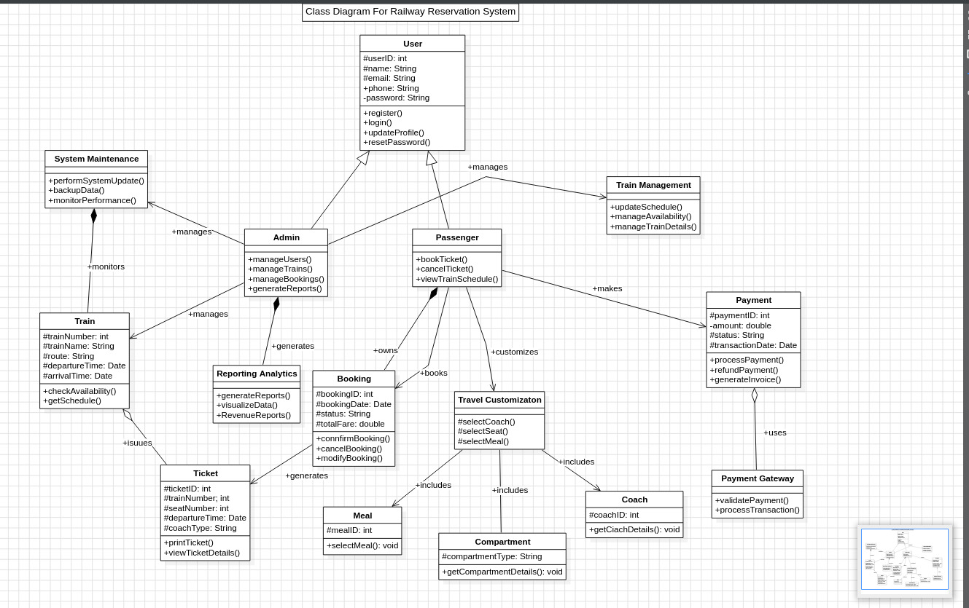
Class diagram:

Slide 16
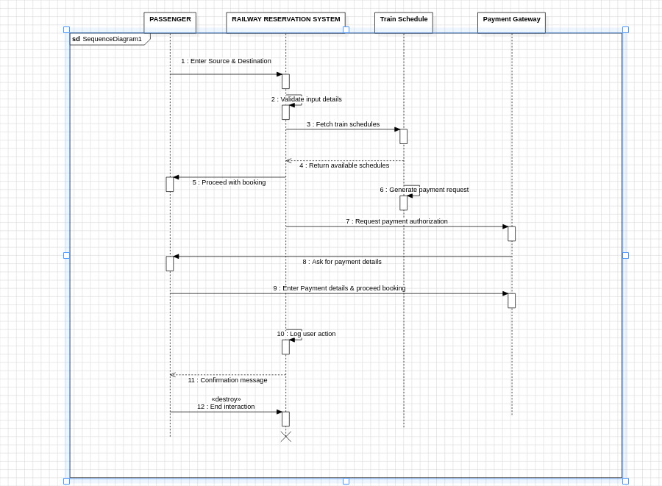
Sequence diagram:

Slide 17
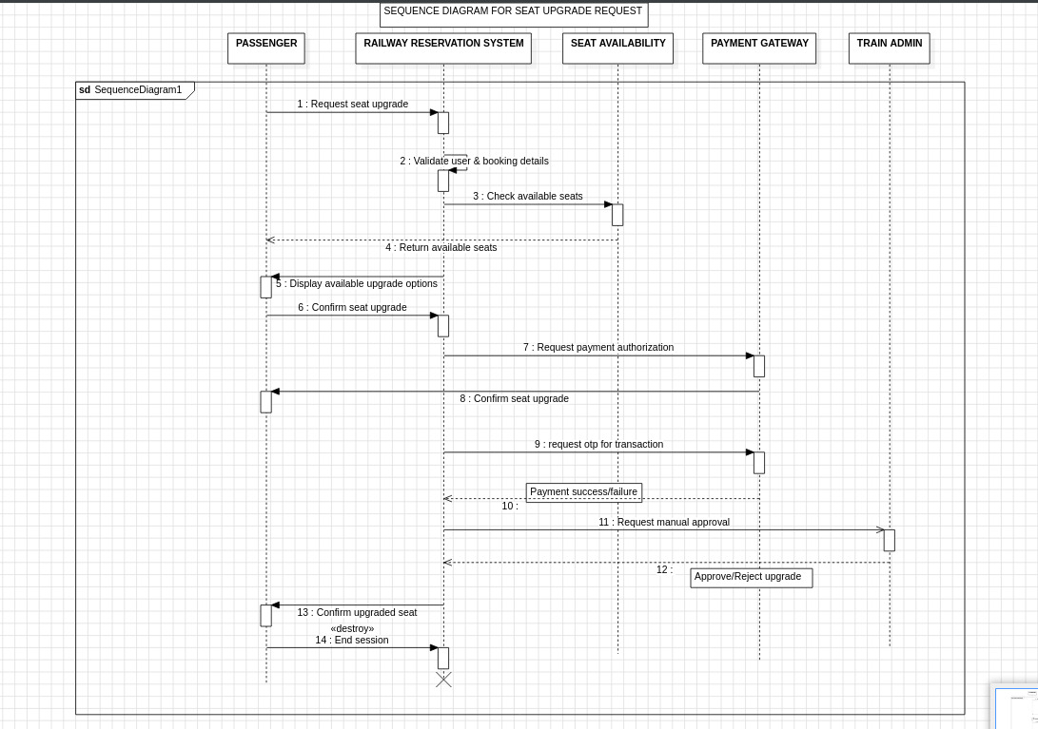

Slide 18
Testing
comprehensive testing for any two scenarios:
Test Case ID: TC001
Test Scenario: Verify login functionality with valid and invalid credentials.
Test Case Description: Ensure the login system accepts correct credentials and rejects incorrect inputs.
Test Steps:
Open the login page.
Enter a username.
Enter a password.
Click the "Login" button.
Test Data: Valid Case: Username: testuser, Password: Pass@123 Invalid Case: Username: wronguser, Password: wrongpass

Slide 19
Test Expected Result:
If valid credentials are entered, the user should be redirected to the dashboard.
If invalid credentials are entered, an error message "Invalid Username or Password" should appear. Actual Result:
valid credentials: redirected to dashboard
Invalid credentials: got error message
Pass/Fail: Pass

Slide 20
Test Case ID: TC002
Test Scenario: Verify password reset functionality.
Test Case Description: Ensure the password reset system sends a reset link to the user's email.
Test Steps:
Open the login page.
Click on the "Forgot Password" link.
Enter a valid username.
Click on the "Reset Password" button.
Test Data:
Valid Case: Username: testuser
Invalid Case: Username: wronguser

Slide 21
Test Expected Result:
If a valid username is entered, a password reset link should be sent to the user's email.
If an invalid username is entered, an error message "Invalid Username" should appear.
Actual Result:
valid username: got password reset link
Invalid username: got error message
Pass/Fail: Pass

Slide 22
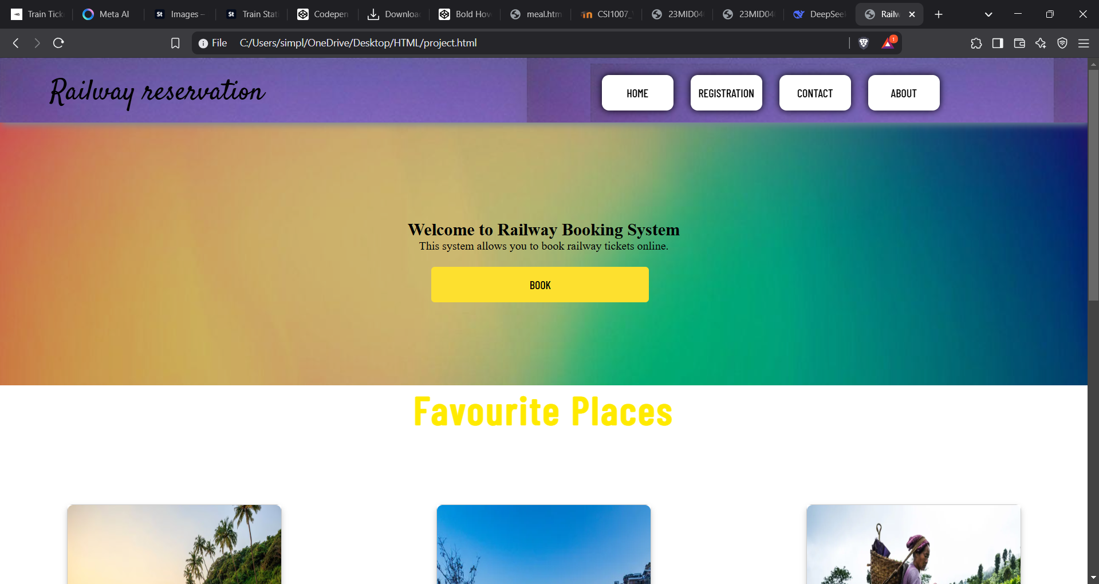
Project – UI Screenshots

Slide 23
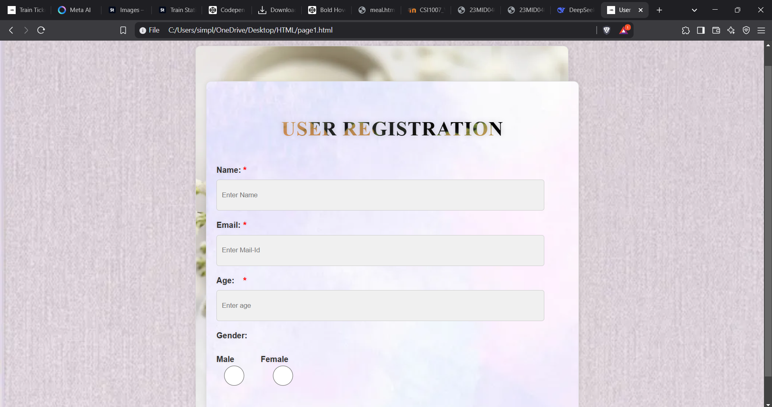
Project – UI Screenshots

Slide 24
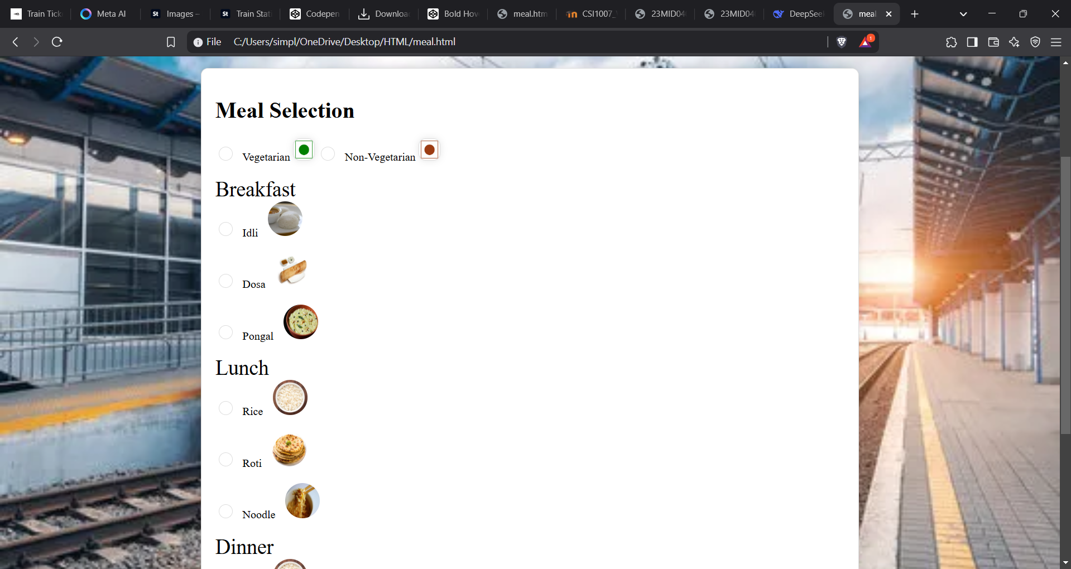
Project – UI Screenshots

Slide 25
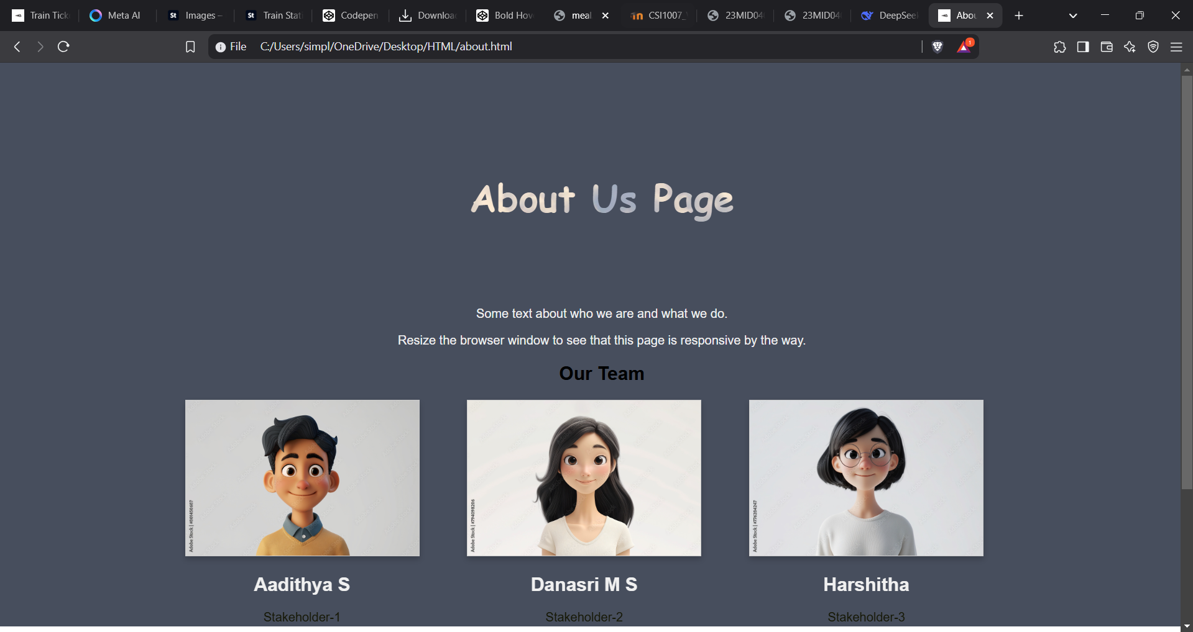
Project – UI Screenshots

